Slide 1

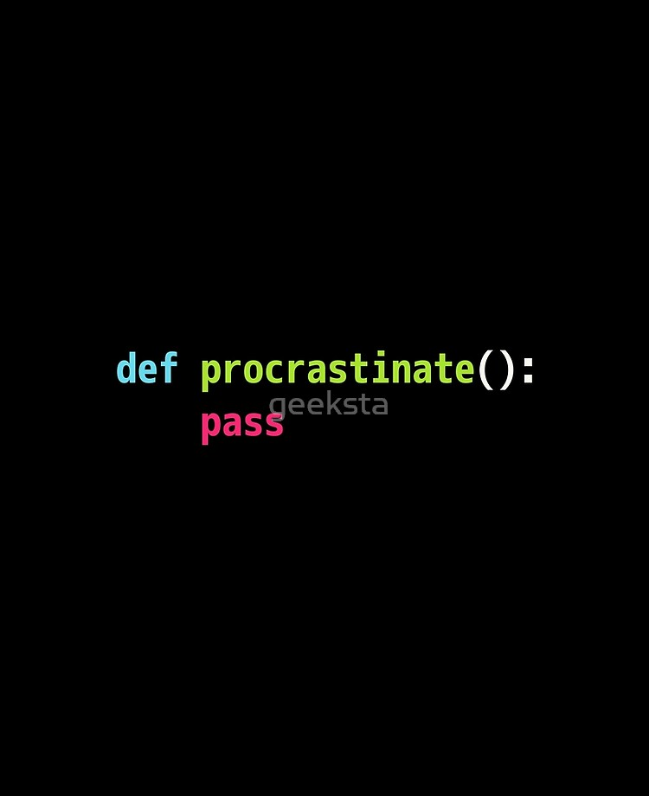
WELCOME TO COFFEE N’ CODE

Slide 2
DO THIS RIGHT NOW!
Join The Slack Channel to always be updated of the content!
Slack Channel : https://bit.ly/uwcoffeencodeslack
Check out Github as well for the presentations and content.
Github - https://github.com/UWCoffeeNCode/W20-Lessons
-

Slide 3
AGENDA FOR TODAY!
Personal and Group Introduction.
01
Agenda for this entire project.
Brief description about how the project will develop with time and what the final product should look like.
Who I am, Who you guys are, What is this all about? Why Game development and much more.
02
Which Software and Programs are required?
How to install Python and Atom, Which module to use and how to check if Python is really working!
03
Our First Python Program!
Get familiar with Python and Atom, how Atom works and how to have the right mindset while coding games.
04
The Basics of Python.
Demonstrations on how to run a code in Python, basic if-else statements, data types in Python and introduction to
Loops and iterations. Also included will be a coding challenge which will be stressed on the concepts mentioned above.
05
COME BACK NEXT WEEK!
A small talk on how I desperately need you guys to come next week ☺
06

Slide 4
Who am I?
Interests and Hobbies:
Web Development.
Game Development.
Hacking! (Ethical obviously xD)
Soccer! (Please leave right now if
you’re a Barca fan. )
Interests and Hobbies:
1. Coding!!!!!!!!!!
2. Playing FIFA.
3. Netflixing?
4. Music (EDMS!)
LEFT
RIGHT

Slide 5
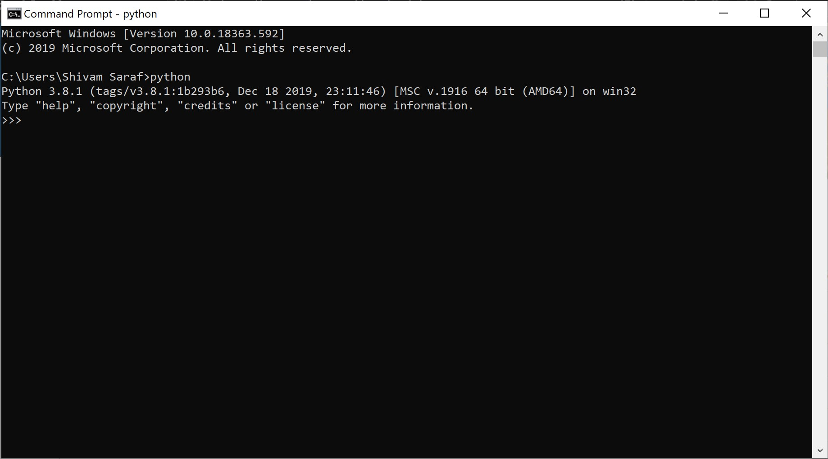
STEP 1 : installing python 3.8.1
Click on this Link in order to be directed to download Python!
https://www.python.org/downloads/
After clicking the appropriate link (depending on whether you are running MacOS or Windows), initialise the set up wizard by agreeing to the terms and conditions!
MAKE SURE TO ALWAYS ADD PYTHON TO YOUR PATH BEFORE FINISHING THE INSTALLATION PROCESS. (Even though this is not recommended by the system, I urge you guys to do it for better and efficient accessibility.)
To check if Python has been installed in the right directory, open your Command Line interface and hit “Python”. If the output is similar to the picture on this slide, YOUR GOOD TO GO!

Slide 6

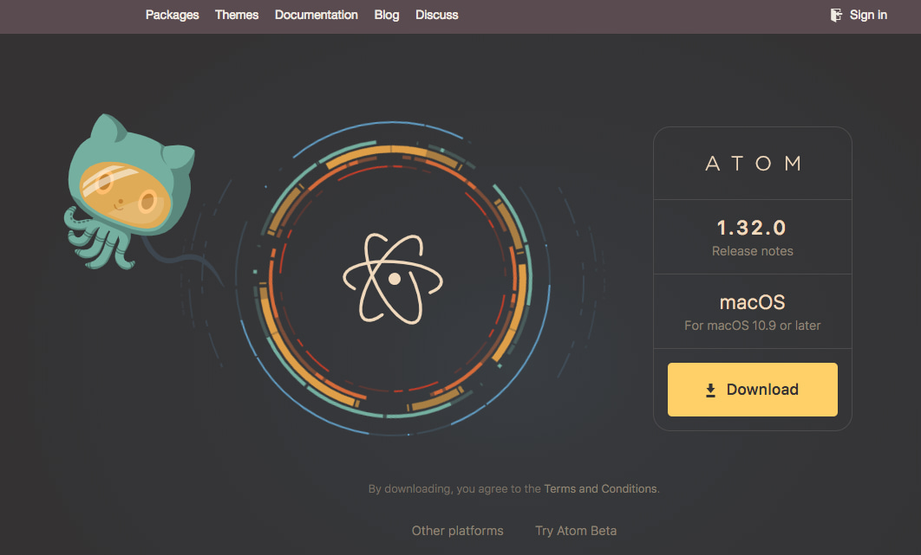
STEP 2: INSTALLING A NEW IDE!
Click on this Link in order to be directed to download ATOM!
https://atom.io/
Follow the set-up process and after installing, run the program!
Next, it is time for us to let ATOM link up with Python! Click settings in ATOM and go to the sub-section called Packages.
Now, search ‘Script’ in the Install sub-section and install it!
We are all set to write our first Python Code in Atom!

Slide 7
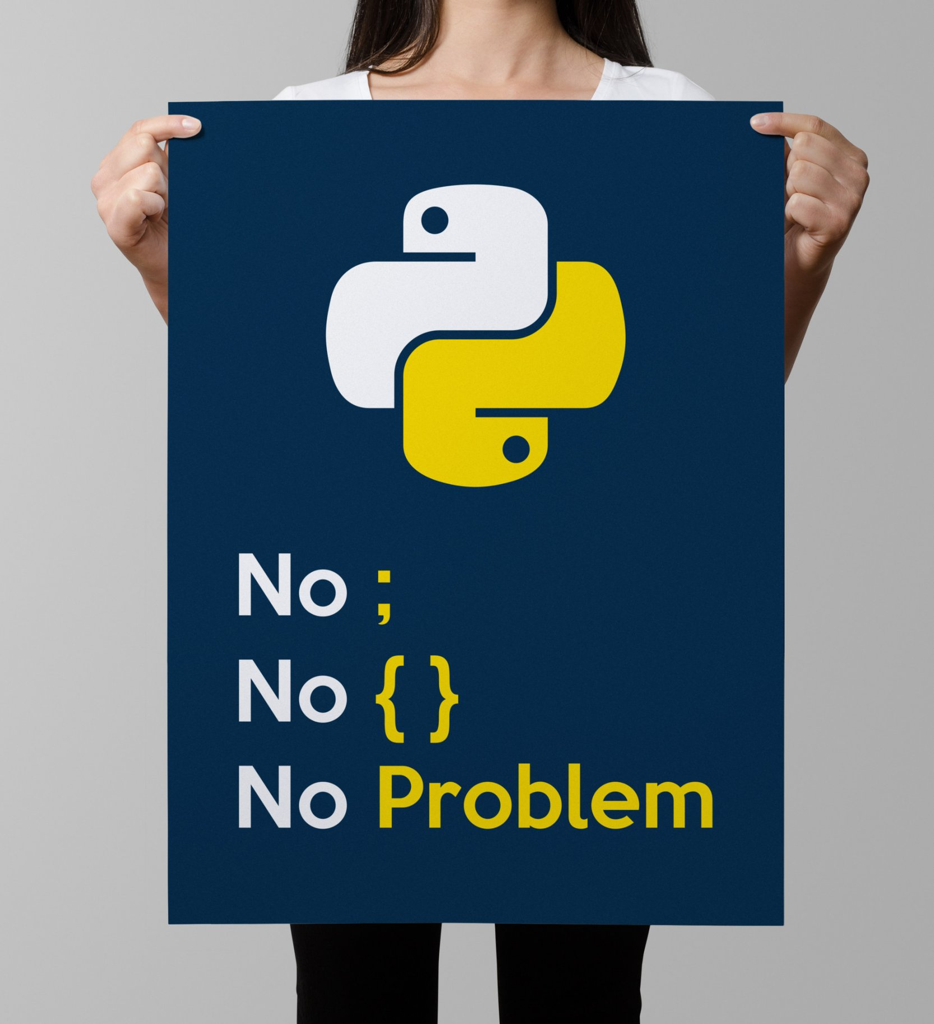
introduction to python programming.
Let’s try to discuss the following and improve our foundations in these topics!
What are variables in Python?
What are the different Data Types? What are their uses?
What are if-else statements? How do you use them?
What are Loops? Do we really need them?
What is an Array? Why do you use it? Is it required for making this game?
What is a Dictionary in Python? What are it’s applications?

Slide 8
Variables!
A Python variable is a reserved memory location to store values and can be easily accessed with the help of identifiers during the run-time of a program!
Identifiers?
The name given to any variable to access them from memory are called identifiers.
There are some rules to name identifiers, for examples, Do not have numbers at the beginning of your identifiers or don’t use special symbols like @,!,# etc. Also, keywords are also not allowed during naming variables!
Keywords?
Think of them as special, reserved words which often convey a special meaning to the language.
They are used to define the structure and syntax of any programming language, so don’t be filthy and use them while naming your variables!
Notes:
Talk about how to initialise a variable, why you should initialise global variables, why mutating in Python is allowed unlike CS 136.

Slide 9
DATA TYPES:
Python has many data types and it’s popularity is mainly due to the availability and the accessibility of these data types.
Data types are vital to a programming language as they are required to classify variables In hopes of accessing them from the memory.
Few of the Data Types in Python include:
Numeric. (Integers, Floats, Complex Numbers)
2. Sequence Type (Lists, Tuples, Strings)
3. Dictionaries.
Notes:
Talk about mutable and immutable objects. (Dictionary and a List can easily be modified)

Slide 10
STRINGS AND INTEGERS:
Two of the most fundamental data types in python are strings and integers.
They can be initialised in the following way.
NOTE: The use of // signifies that the compiler will not process these lines and they are solely used by us for the sake of documentation and understandability.
bruh = 18 // Following is the way to initialize an integer variable in Python. You do not need to
// declare the type of the variable before initializing!
Gaming = “Cool” // This will create a variable called Gaming which has the string “Cool” stored
// inside it!
Additionally, we can change the value held by these variables during the later stages of a program as well! The following perfectly works in Python,
Gaming = “Amazing” // We have now changed the value held inside our variable!.
Notes:
How do we check our changes though? How do we display something on our screens?

Slide 11
Accepting input from a user!
During programming, a programmer hardly enters inputs for the functioning of his/her program. Rather, the job of inputting values is left for the user to improve user experience.
the process of accepting input in python is via the ‘input’ command!
Given below is the general syntax for the ‘input’ statement:
// Say you want to write a program which would provide an opportunity to the user to enter
// values during the run-time of a program. This is how you would do it:
a = input(“Please enter a number”);
// The use of a string inside the two brackets after ‘input’ will display a message on the Screen
// for the user. After entering a value, a string or even an integer, it will get stored in the variable a
// and can be accessed anytime from the memory.

Slide 12
Printing in python!
How do we check the changes we just implemented on our Gaming variable?
We print them and see what the computer outputs!
Printing in python is very user friendly, as it literally involves you telling the computer to Print!
print(Gaming) // Will show what the variable ‘Gaming’ contains! (Will display the string)
print(bruh) // Will show the value stored inside the variable ‘bruh’, that is, 18.
FUN FACT!!!!
Consider the following piece of code:
First = “Computer”
Last = “Science”
// What do you think will be produced on typing the command? : print(First + Last)

Slide 13
In short, we can use the ‘+’ sign to effectively concatenate strings. (join them together)
In the case of integers and numeric in general, the ‘+’ effectively acts as an operator and performs addition on the two operands.
But……..
What do you think will be produced by the following line of code?
print(“Coding” + “is” + “amazing” + 136)
// That’s right! The compiler will generate an error as Python does not allow you to concatenate
// two different data types in the same print statement.
// How do we solve such a problem? We can effectively change the data type of our integer into a
// string and then allow Python to print the statement!
print(“Coding” + “is” + “amazing” + str(136)) // Here, adding str effectively converts 136 into “136” which behaves like a string! This process of type conversion is called TYPE CONVERSION.
Notes:
Talk more about print statements and clarify any questions if required.

Slide 14
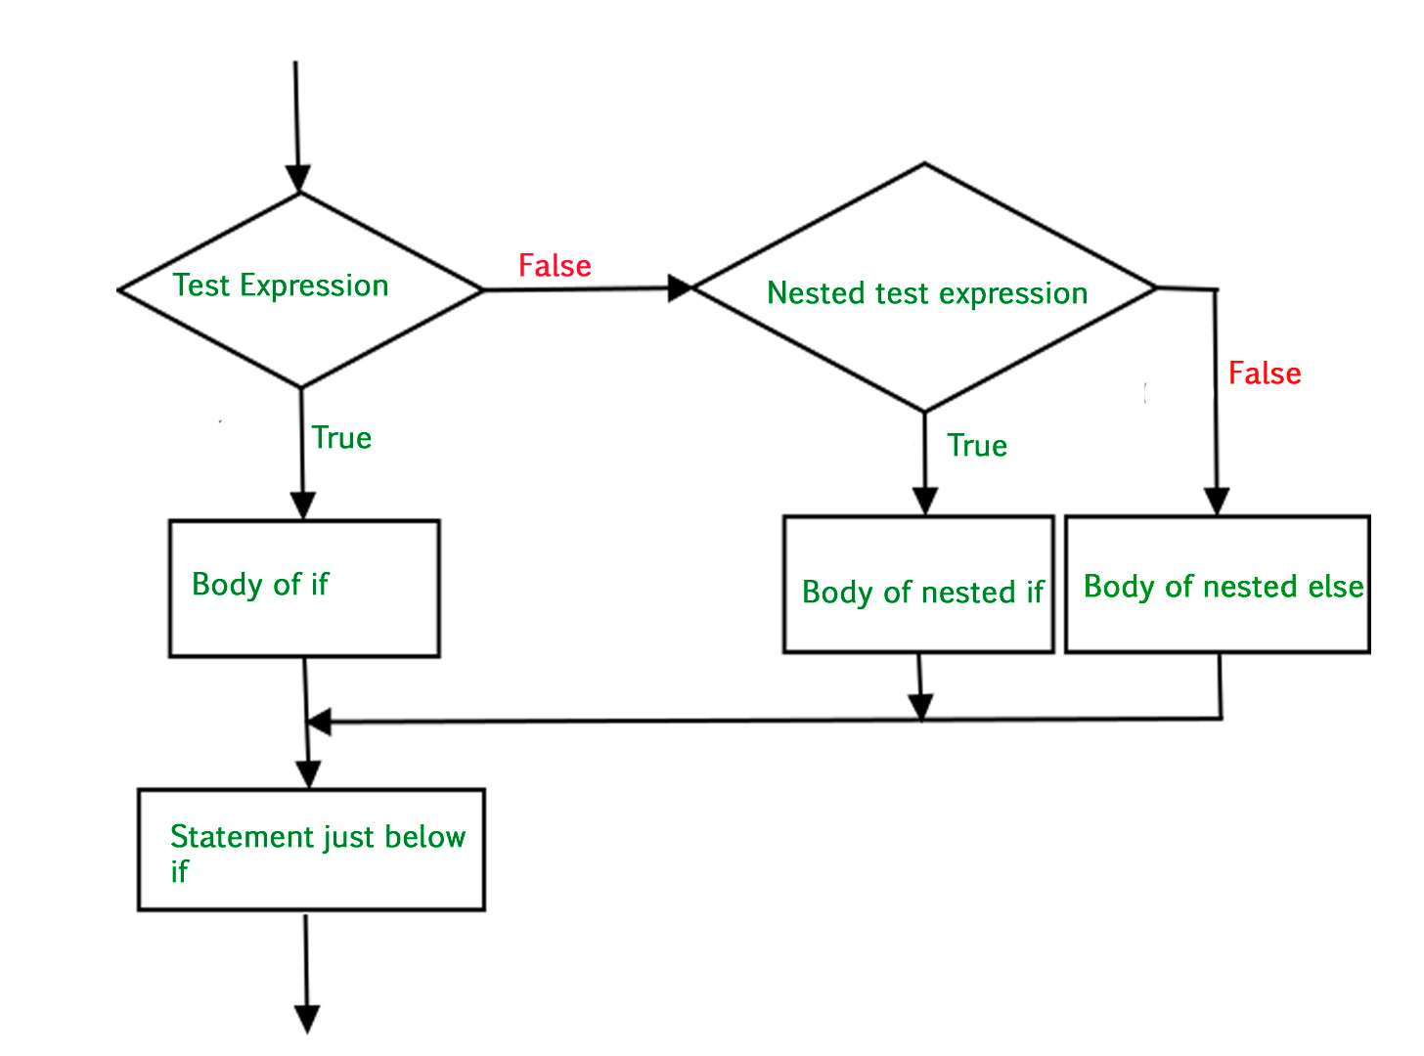
Conditionals in python:
Basic mathematical operators function the same way in python and their implementations are truly based on your intuition and thinking. For example, > works the same way and the we write our operands in the same manner ( 2 + 3 >= 5 produces?)
Thus, Let’s now talk about if else statements!
General Syntax of If-Else statements:
a = 200 b = 33 if (b > a): print("b is greater than a") elif (a == b): print("a and b are equal") else: print("a is greater than b")
Notes:
Work with more examples, answer Questions.

Slide 15
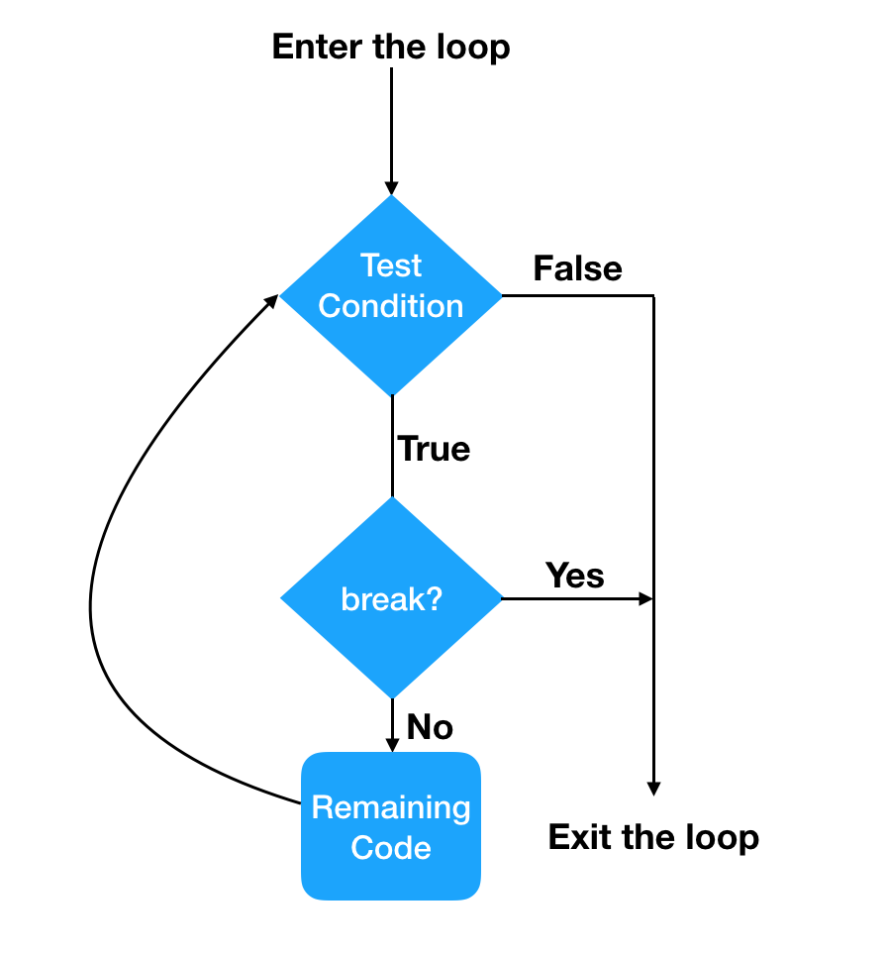
Looping and iterations:
Good news: We do not need to talk about recursions in python!
Bad news: We need to learn looping and the power of indentations in python.
For loops -
General Syntax of For Looping:
for i in range(0,100):
print(“YO”)
// The following code prints out “Yo” 100 times at a new line every
// single time. This is how a general for loop works in Python and it’s
// syntax and understanding is very fundamental for the development
// of this game.
Notes:
Talk about the diagram attached beside and also while loops.

Slide 16
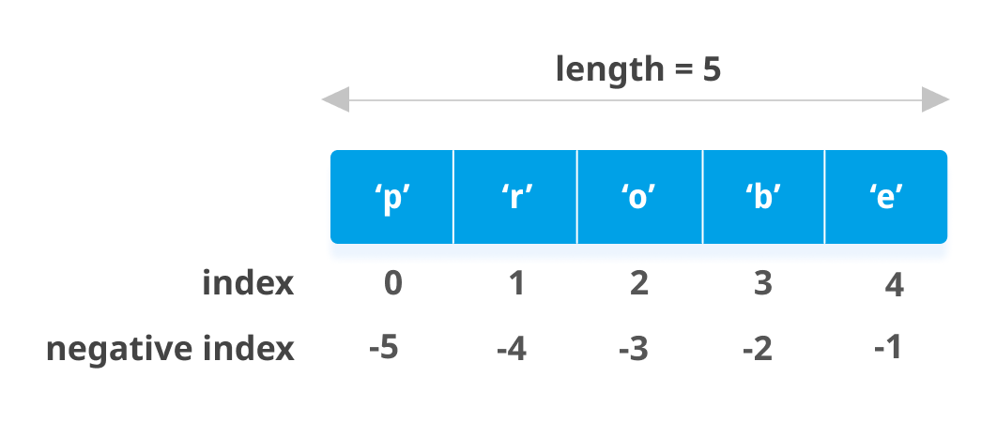
What if we want to store multiple values under the same variable name?
For this purpose, lists are given a lot of importance and significance.
In this game, the use of lists is vital to develop multiple enemies and allies which thus will stress on code reusability and efficiency.
Arrays in python are totally different than lists!
General Syntax for declaring a List in Python:
a = [] //Creates a List which has no elements in it.
b = [3, 5, 6, 7] // Creates a List with the following elements.
// The way to access elements in a list is quite simple. As
// shown in the picture, each element has a position assigned
// to it. (The very first position is always 0!)
print(b[0]) // This line of code produces 3 as it’s the first element in the list b.

Slide 17
Topics to cover next week!
Functions!
Classes and objects!
Turtle module!
Inheritance and code reusability!
Fun Coding Challenge!
Ask the user for a number. Depending on whether the number is even or odd, print out an appropriate message to the user!
(Hint: Think about remainders when dividing two integers!)

